Slide 1



Towards Lightweight Time Series Forecasting: A Patch-wise Transformer with Weak Data Enriching
Meng Wang, Jintao Yang, Bin Yang*, Li Hui, Tongxin Gong, Bo Yang, Jiangtao Cui

Slide 2
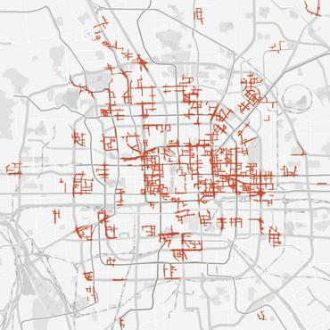
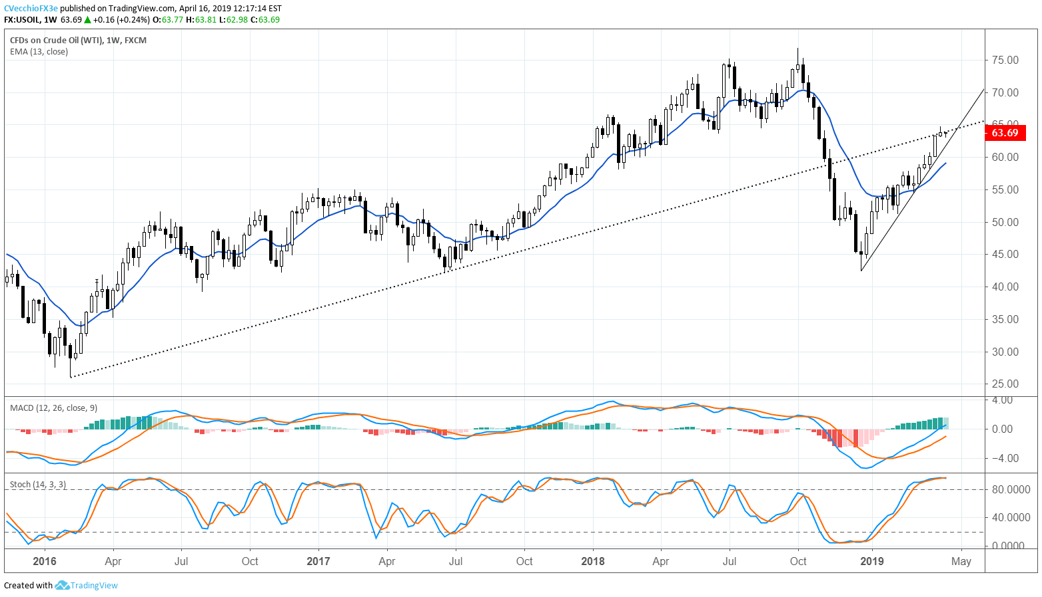
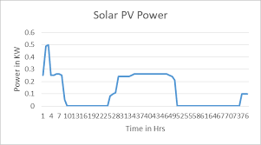
Research Background
Time Series Forecasting (TSF)
Motivations :
Transformer architecture is not specifically optimized for time series. High computational cost in Transformer-based models, especially for resource-constrained scenarios.
Inefficient use of external covariates (future covariates) by relying solely on historical data.
Existing Solutions :
Accuracy-focused: Informer, Autoformer, Fedformer.
Efficiency-focused: TSMixer, LightTS.
Weather
Holiday & news
Light intensity
Traffic
Finance
Renewable resource power generation
Notes:
transformer is mentioned in the nlp domain, however text disorder has less impact on comprehension, unlike time series.

Slide 3
Motivation
Our Goal :
Lightweight Transformer with weakly supervised learning.
Challenges:
Differentiate between components in Transformers effective and those of lesser importance.
A unified multimodal framework is lacking in extracting features from explicit future covariate.
Not all scenarios possess available explicit future covariates.
Notes:
goal

Slide 4
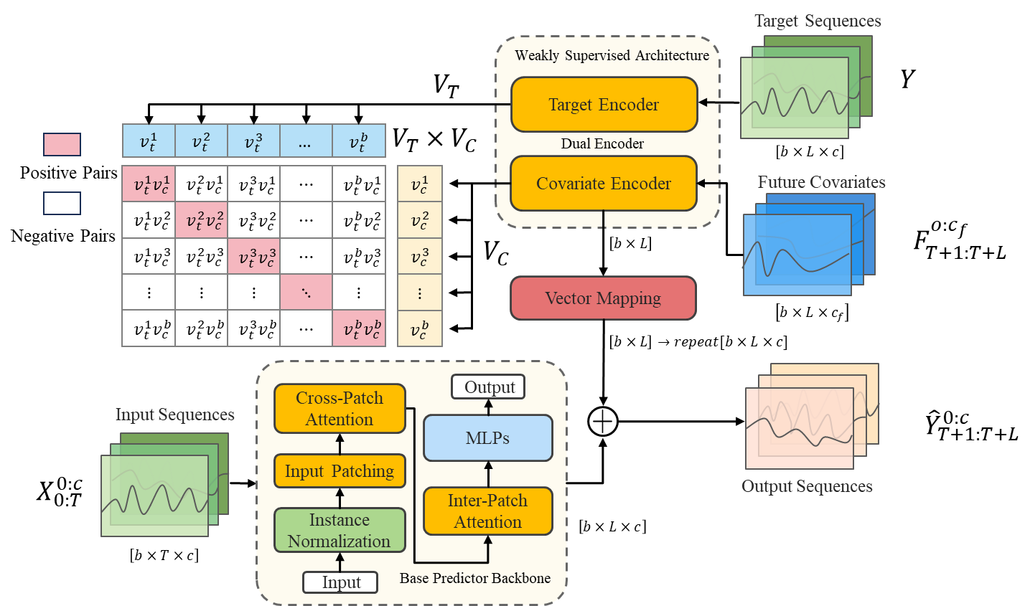

LiPFormer Architecture
Input : Historical time series $X_{0:T}^{0:c}$+ Future weak covariates $F_{T+1:T+L}^{0:c_{f}}$.
Combining covariate information
Lightweight patch-wise Transformer

Slide 5
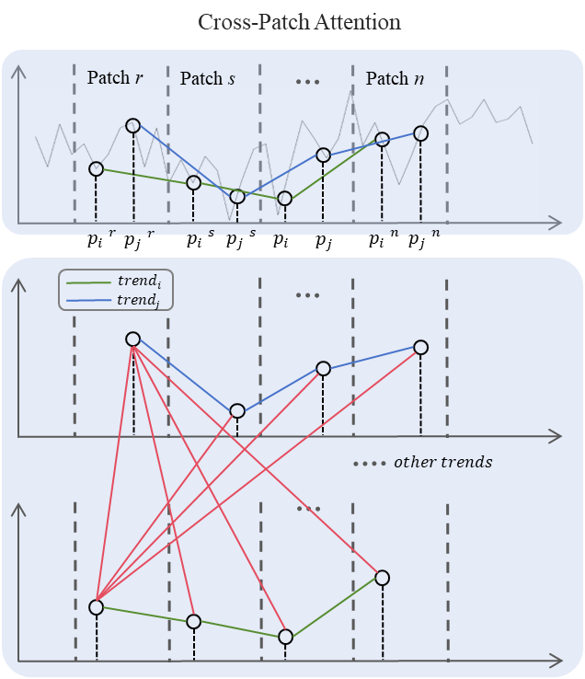
Cross-Patch Attention
Models global trend correlations across patches :
Extracts fixed-position data points (ith point in each patch) to build trend sequences spanning all patches.
Applies attention across these trend sequences to capture global sequential dependencies and dynamics.

Slide 6
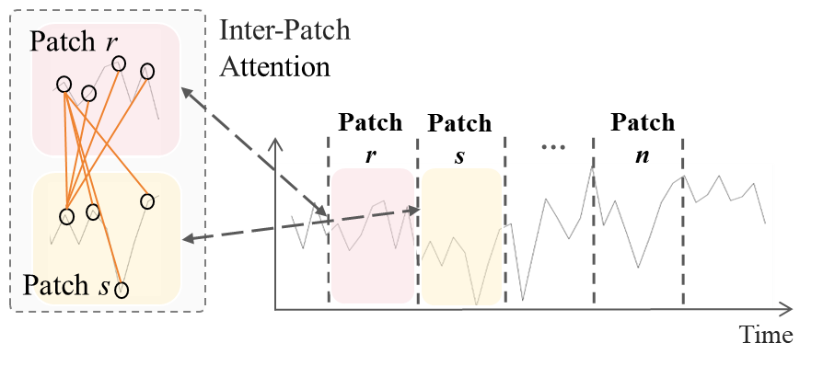
Inter-Patch Attention
Captures local dependencies within individual patches :
Uses self-attention-like operations to model correlations between data points across patches (e.g., relevance between patch pairs: patch r and patch s ).

Slide 7
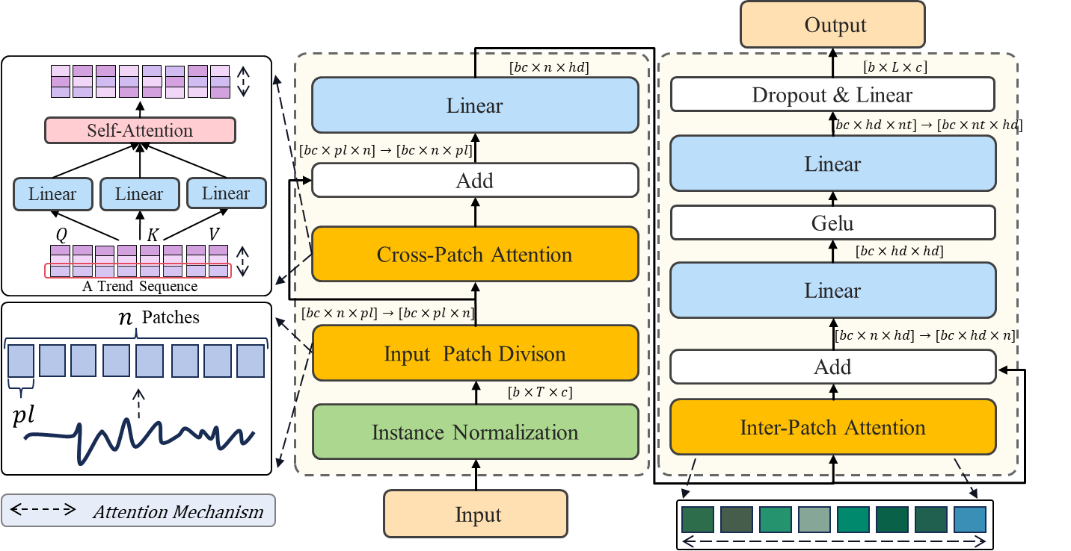
Lightweight Design
Simplified Architecture : Eliminates Positional Encoding (PE) , Layer Normalization (LN) , and Feed-Forward Networks (FFNs) to reduce complexity.

Slide 8
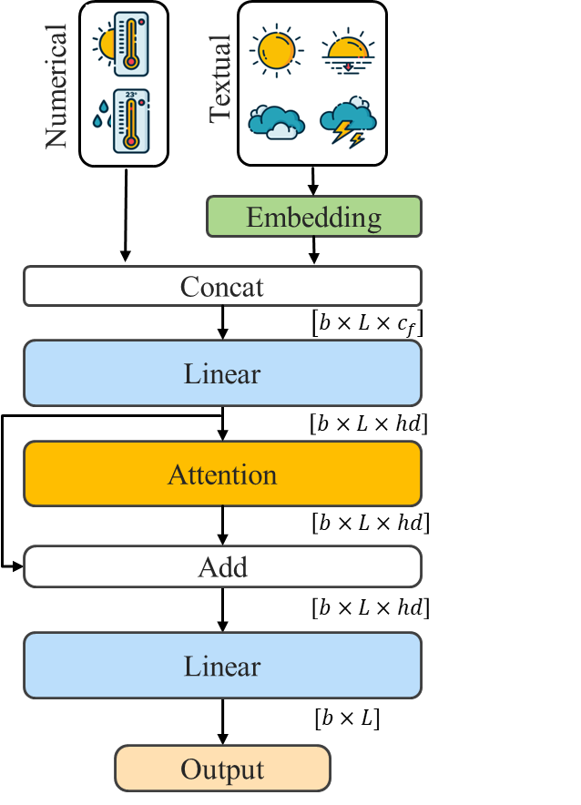
Covariate Encoder
Map discrete data into continuous vectors
Aligns textual, numerical, and temporal contexts —— a unified multimodal framework.
Generalized to datasets without explicit covariates.
During prediction, we freeze the parameters of the Covariate Encoder, and it is used to guide the backbone.
Notes:
修改很多

Slide 9
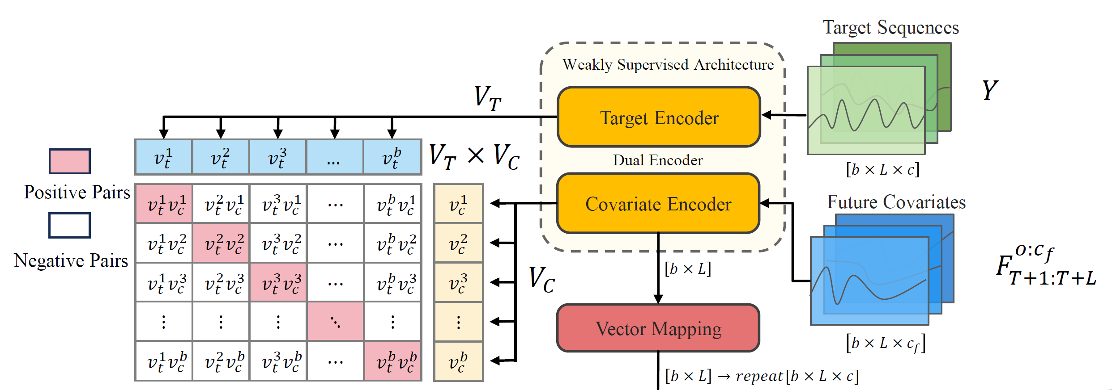
Weakly Supervised Architecture
Employs a dual encoder architecture to model relationships between future covariates and target sequences via contrastive learning.
Leverages explicit and implicit weak labels as future covariates, providing guidance for base predictor .

Slide 10
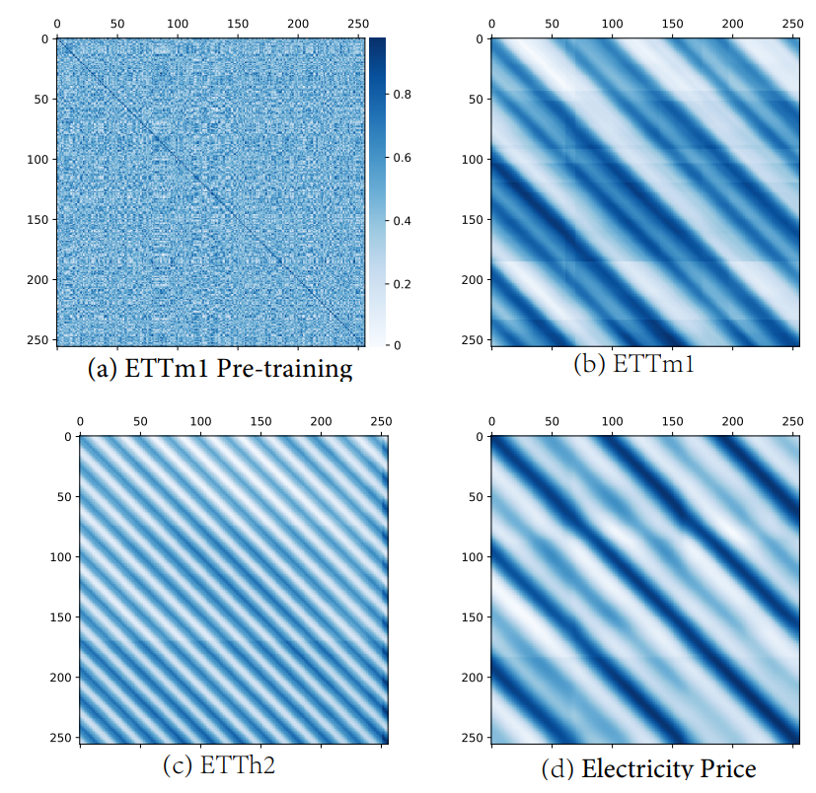
Visualization
Representation alignment between latent vectors of predictions and future covariates (X/Y-axis).
Validates model’s ability to capture temporal (periodic) dependencies and weak label correlations.
Supports effectiveness of contrastive learning and pre-training paradigm.
Logits matrices
Training process
Validation process
Notes:
We made an interesting discovery, we observe clear periodicity alongside irregularities at the edges of “stripes”, including less pronounced “blurred stripes” within these periods. These patterns support the role of explicit weak labels in guiding predictions, consistent with our inductive bias that future covariates correlate with time series models.

Slide 11
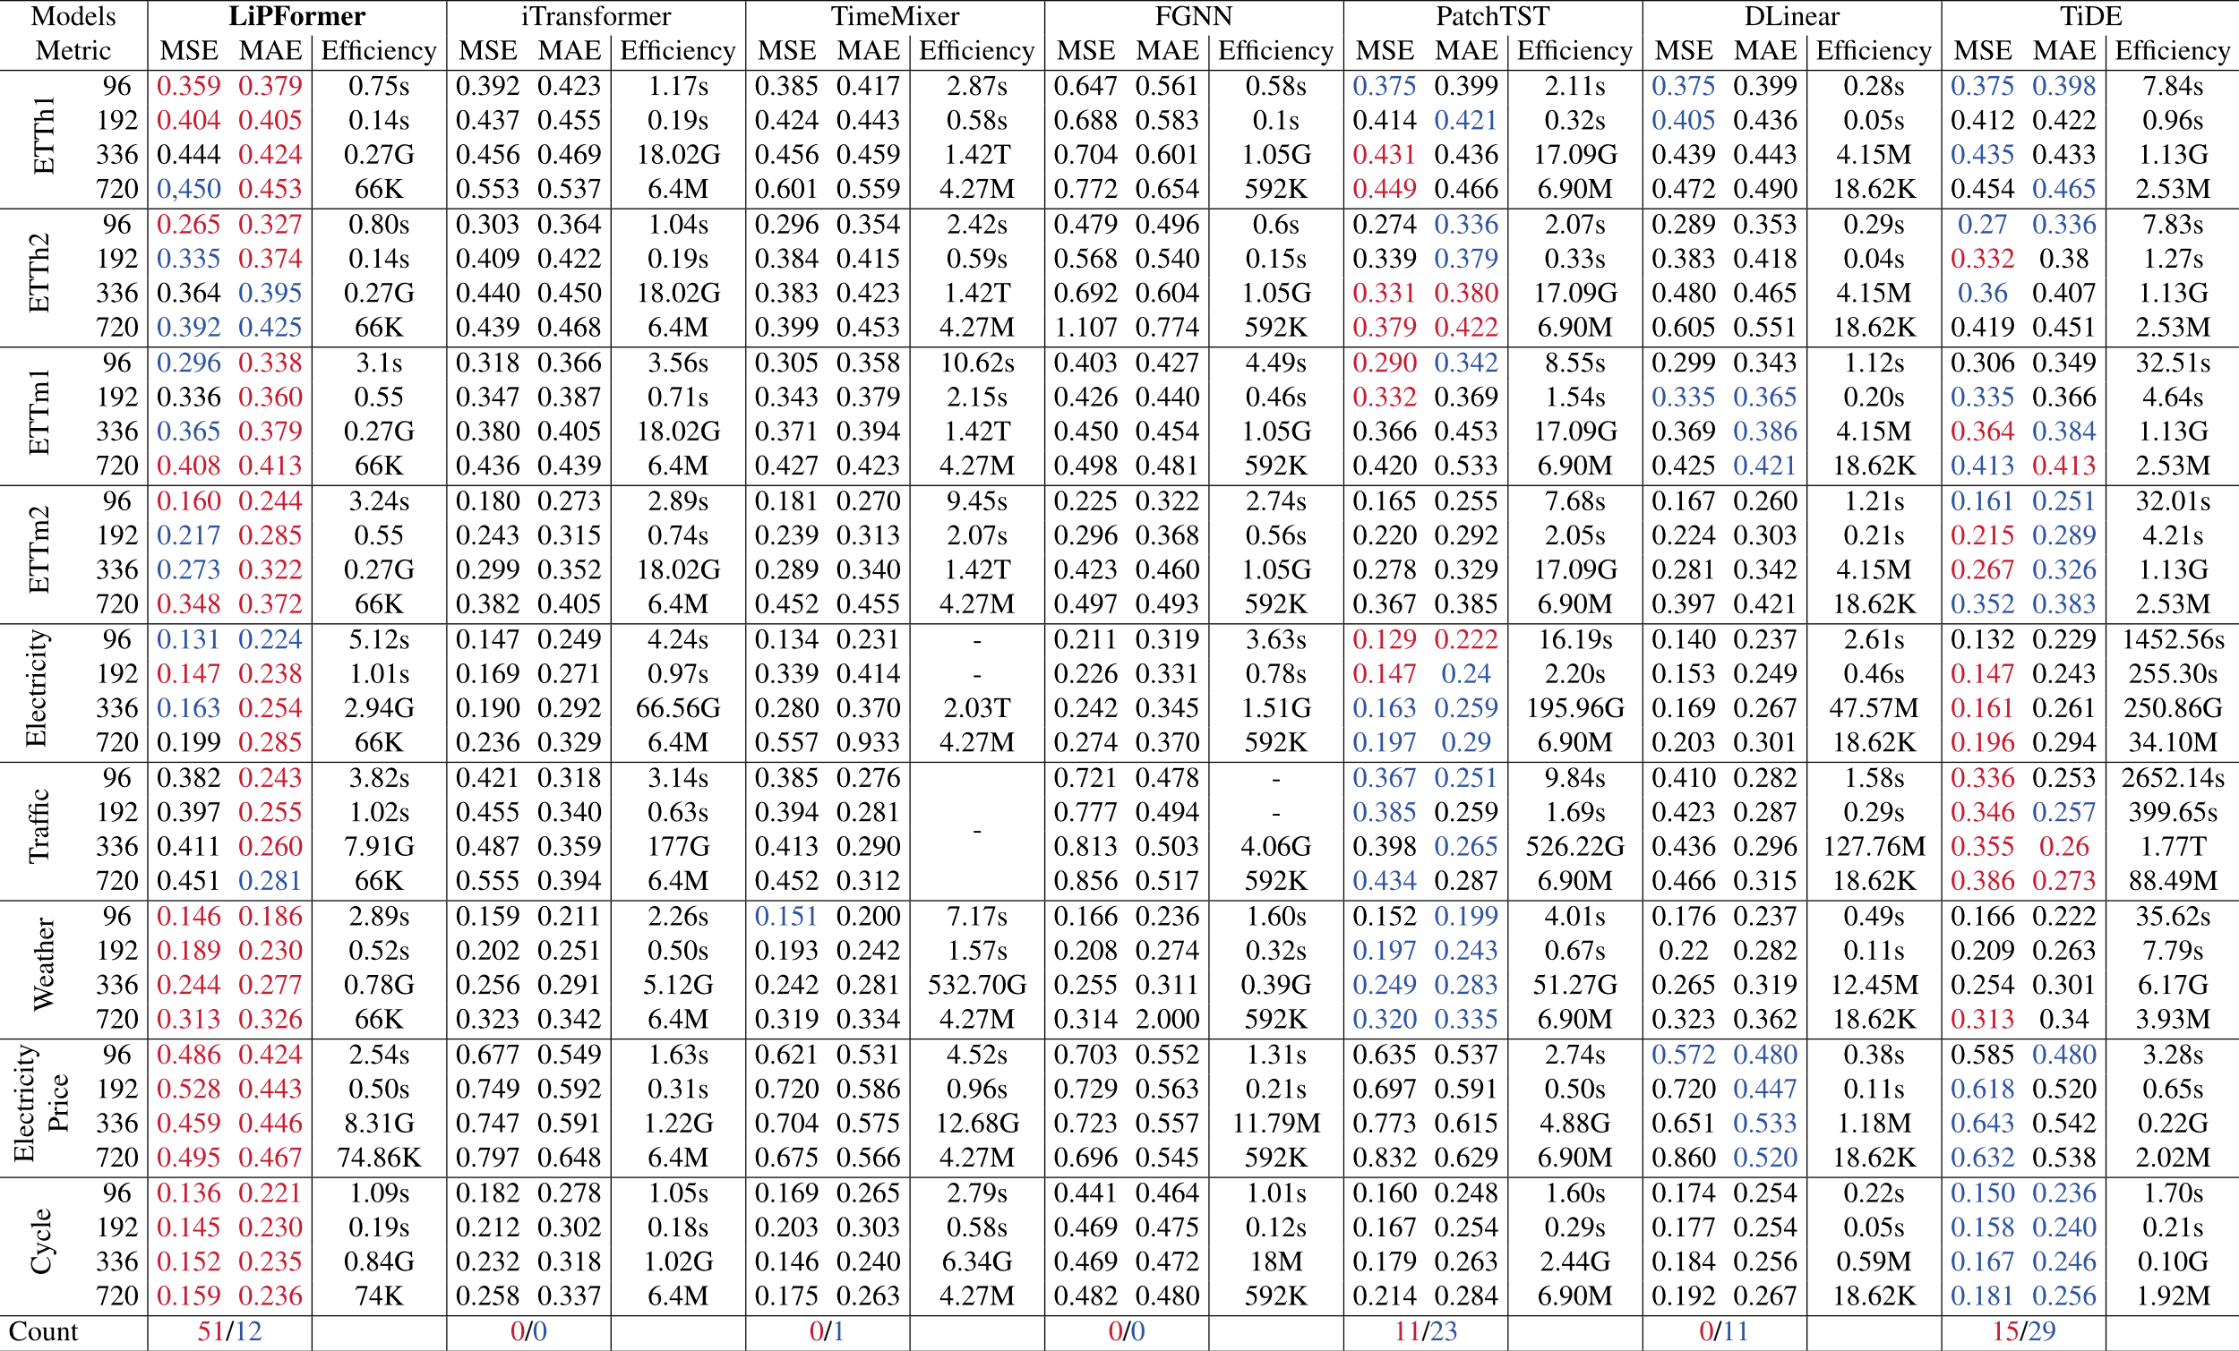
Accuracy Comparison
Surpasses DLinear, iTransformer, TimeMixer, FGNN, and strong baselines PatchTST and TiDE by 8.3% and 5.4% , respectively.

Slide 12
Efficiency Comparison
ETTh1: LiPFormer achieves ~10x faster inference than Transformer for input length 336.
Weather Dataset: LiPFormer shows ~2x speedup despite higher channel count.
Memory Limitations: Transformer exceeds memory limits for input length 720 on both datasets.
Datasets | ETTh1 |  |  |  | Weather
Input length | 96 | 192 | 336 | 720 | 96 | 192 | 336 | 720
Transformer | 1.47 | 2.86 | 5.82 | - | 1.84 | 3.88 | 6.08 | -
LiPFormer | 0.55 | 0.60 | 0.62 | 0.74 | 0.87 | 1.35 | 3.77 | 4.57
FFNs and LN (designed for NLP tasks) are ineffective for time series data.
Model | Metric | ETTh1 |  |  |  | ETTm2
 |  | 96 | 192 | 336 | 720 | 96 | 192 | 336 | 720
LiPFormer +FFNs | MSE | 0.389 | 0.439 | 0.514 | 0.523 | 0.184 | 0.217 | 0.282 | 0.521
 | MAE | 0.408 | 0.441 | 0.478 | 0.497 | 0.271 | 0.285 | 0.330 | 0.466
LiPFormer +LN | MSE | 0.392 | 0.437 | 0.448 | 0.508 | 0.158 | 0.218 | 0.266 | 0.350
 | MAE | 0.412 | 0.435 | 0.453 | 0.498 | 0.243 | 0.286 | 0.317 | 0.376
LiPFormer +FFNs+LN | MSE | 0.754 | 0.505 | 0.614 | 0.498 | 0.164 | 0.226 | 0.284 | 0.360
 | MAE | 0.557 | 0.465 | 0.524 | 0.497 | 0.252 | 0.292 | 0.332 | 0.381
LiPFormer | MSE | 0.359 | 0.404 | 0.444 | 0.450 | 0.160 | 0.217 | 0.273 | 0.348
 | MAE | 0.379 | 0.405 | 0.425 | 0.453 | 0.244 | 0.285 | 0.322 | 0.372
Lightweight design outperforms standard Transformer architectures in efficiency and accuracy performance.

Slide 13
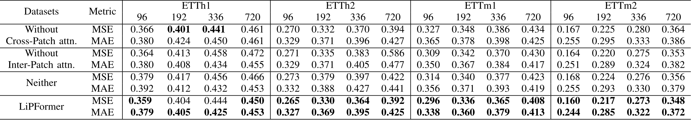
Component Analysis
Cross-Patch and Inter-Patch attention are complementary :
Individual use of either mechanism yields limited accuracy improvements.
Combining both mechanisms consistently enhances robustness across all datasets, reducing MSE by 5% and MAE by 3% , validating their necessity for collaborative design.

Slide 14
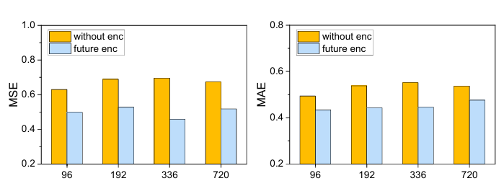
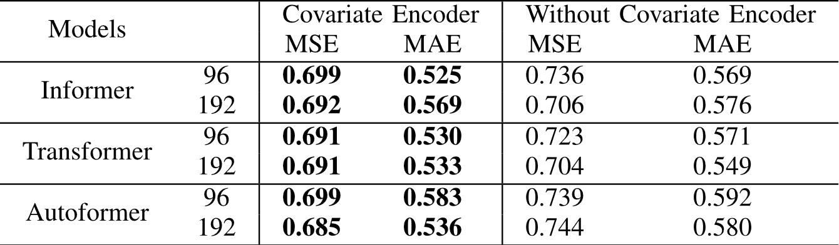
Covariate Encoder
The Covariate Encoder enhances prediction accuracy by leveraging weak labels (e.g., weather, time features)
As a plug-in, the covariate encoder can benefit other time series models.

Slide 15
Key Contributions
LiPFormer : A patch-wise Transformer with:
Cross-Patch Attention / Inter-Patch Attention
Lightweight Transformer components (FFN, LN, etc.).
Weakly Supervised Covariate Encoder :
Dual-encoder contrastive learning for implicit temporal and explicit future contexts.
Plug-and-Play Compatibility : Seamlessly transplanted into diverse models.
State-of-the-Art Performance :
Superior improves both accuracy and efficiency in TSF tasks.

Slide 16
Thank you! Q&A
Towards Lightweight Time Series Forecasting: a Patch-wise Transformer with Weak Data Enriching

